Slide 1
SIX SIGMA
KEYA GANDHI
160410116035
SY IT 1 (B)

Slide 2
INTRODUCTION
It is a set of technique and tools for process development.
It was developed by MOTOROLA in 1986.
Sir Bill Smith - The father of six sigma.

Slide 3
CHARACTERISTICS
Characteristics of six sigma
Statistical Quality Control
Methodical Approach
Fact and Data Based Approach
Project and Objective Based Focus
The Customer Focus
Teamwork Approach to Quality Management

Slide 4
OBJECTIVES
Overall business improvement
Remedy defects/variability
Reduce costs
Improve cycle time
Increase customer satisfaction

Slide 5
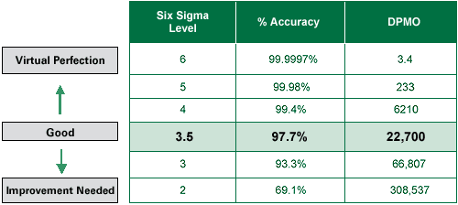
LEVELS

Slide 6
METHODOLOGIES
DMAIC
DEFINE
MEASURE
ANALYZE
IMPROVE
CONTROL
DMADV
DEFINE
MEASURE
ANALYZE
DESIGN
VERIFY

Slide 7
SOFTWARE USED
Arena
ARIS six sigma
MATLAB
Microsoft Visio
STATA
STATISTICA
And Many more……

Slide 8
CASE STUDY
Catalent Pharma Solution, is a leader in developing solutions for the pharmaceutical, ventenary, biological and consumer health industries.
The company was faced with high numbers of defects after producing millions of units.
The process flow was slow because of the time required to analyze the samples.
Six sigma processes were applied to address these issues.

Slide 9
CONT…
The company specifically required a solution for their proprietary product known as Zydis.
The company needed new systems that would help to predict the process variation.
The improvements are also supposed to help operators understand statistical analyses.
The project team devised a database to collect information.

Slide 10
CONT…
Control charts were also completed and entered automatically.
The programming language used for automation was flexiable and easy to replicate.
The efficiency was improved by making these changes.
After two weeks of implementing Six Sigma processes, the company prevented the loss of two batches of product, which was worth 50,000 pounds. (5101500.00 Indian Rupees)

Slide 11
CONCLUSION
This case study demonstrates how companies can improve processes to meet Six Sigma standards, prevent loses and save money.
Companies that save money can reallocate the funds towards research and design or improvement of other processes.

Slide 12
THANK YOU...

